Slide 1
Dynamic Host Configuration Protocol (DHCP)
June 23, 2015

Slide 2
Agenda
DHCP Introduction
How DHCP Works
Message Flow
DHCP Relay Agents

Slide 3
DHCP Introduction
The Dynamic Host Configuration Protocol (DHCP) is based on the Bootstrap Protocol (BOOTP) and was built from 1993. which provides the framework for passing configuration information to hosts on a TCP/IP network.
DHCP adds the capability to automatically allocate reusable network addresses and configuration options to Internet hosts
DHCP consists of two components:
a protocol for delivering host-specific configuration parameters from a DHCP server to a host
a mechanism for allocating network addresses to hosts.
DHCP is built on a client/server model, where designated DHCP server hosts allocate network addresses and deliver configuration parameters to dynamically configured hosts.

Slide 4
DHCP Introduction
A DHCP infrastructure consists of the following elements:
DHCP servers: computers that offer dynamic configuration of IPv4 addresses and related configuration parameters to DHCP clients.
DHCP clients: network nodes that support the ability to communicate with a DHCP server to obtain a dynamically leased IPv4 address and related configuration parameters.
DHCP relay agents: network nodes (e.g., routers) that listen for broadcast and unicast DHCP messages and relay them between DHCP servers and DHCP clients. Without DHCP relay agents, you would have to install a DHCP server on each subnet that contains DHCP clients.
All DHCP messages are sent using the User Datagram Protocol (UDP).
DHCP servers listen on UDP port 67.
DHCP client listen on UDP port 68.
DHCP relay agents listen on both UDP ports

Slide 5
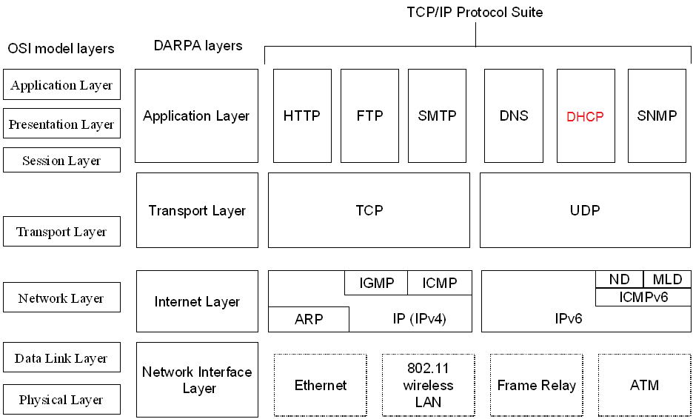
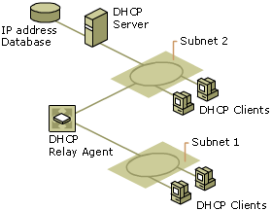
DHCP Introduction

Slide 6
DHCP Introduction
Benefits of using DHCP
Users no longer need to acquire IPv4 address configurations from a network administrator to properly configure TCP/IP.
When a DHCP client is started, it automatically receives an IPv4 address configuration that is correct for the attached subnet from a DHCP server.
When the DHCP client moves to another subnet, it automatically obtains a new IPv4 address configuration for that subnet.
The DHCP server supplies all of the necessary configuration information to all DHCP clients.
As long as the DHCP server has been correctly configured, all DHCP clients of the DHCP server are configured correctly

Slide 7
How DHCP Work?
Each time a DHCP client starts:
it requests IPv4 addressing information from a DHCP server, including:
IPv4 address
Subnet mask
Additional configuration parameters:
default gateway address,
Domain Name System (DNS) server addresses,
DNS domain name,
Windows Internet Name Service (WINS) server addresses.
it uses the alternate configuration when it cannot contact a DHCP server (Windows)
Automatic Private IP Addressing (APIPA) address or an alternate configuration that has been configured manually

Slide 8
How DHCP Work?
When a DHCP server receives a request:
it selects an available IPv4 address from a pool of addresses defined in its database (along with other configuration parameters) and offers it to the DHCP client.
if the client accepts the offer, the IPv4 addressing information is leased to the client for a specified period of time

Slide 9
Message Flow
Server A
Client
Server B
Client attempts to discover available DHCP servers
DHCPDISCOVER
DHCPDISCOVER
Servers reply with offers
DHCPOFFER
DHCPOFFER
Client collects offers and decides which offer to accept
Client broadcasts request for one of the received offers
DHCPREQUEST
DHCPREQUEST
Server acknowledges client’s use of IP address
Configuration complete
DHCPACK
Graceful shutdown
Client explicitly releases use of IP address
DHCPRELEASE

Slide 10
Message Flow
Message Type | Description
DHCPDiscover | The first time a DHCP client computer attempts to log on to the network, it requests IP address information from a DHCP server by broadcasting a DHCPDiscover packet. The source IP address in the packet is 0.0.0.0 because the client does not yet have an IP address. The message is either 342 or 576 bytes long—older versions of Windows use a longer message frame.
DHCPOffer | Each DHCP server that receives the client DHCPDiscover packet responds with a DHCPOffer packet containing an unleased IP address and additional TCP/IP configuration information, such as the subnet mask and default gateway. More than one DHCP server can respond with a DHCPOffer packet. The client will accept the first DHCPOffer packet it receives. The message is 342 bytes long.
DHCPRequest | When a DHCP client receives a DHCPOffer packet, it responds by broadcasting a DHCPRequest packet that contains the offered IP address, and shows acceptance of the offered IP address. The message is either 342 or 576 bytes long, depending on the length of the corresponding DHCPDiscover message.
DHCPAcknowledge (DHCPAck) | The selected DHCP server acknowledges the client DHCPRequest for the IP address by sending a DHCPAck packet. At this time the server also forwards any optional configuration parameters. Upon receipt of the DHCPAck, the client can participate on the TCP/IP network and complete its system startup. The message is 342 bytes long.
DHCPNak | If the IP address cannot be used by the client because it is no longer valid or is now used by another computer, the DHCP server responds with a DHCPNak packet, and the client must begin the lease process again. Whenever a DHCP server receives a request for an IP address that is invalid according to the scopes that it is configured with, it sends a DHCPNak message to the client.
DHCPDecline | If the DHCP client determines the offered configuration parameters are invalid, it sends a DHCPDecline packet to the server, and the client must begin the lease process again.
DHCPRelease | A DHCP client sends a DHCPRelease packet to the server to release the IP address and cancel any remaining lease.
DHCPInform | DHCPInform is a new DHCP message type, defined in RFC 2131, used by computers on the network to request and obtain information from a DHCP server for use in their local configuration. When this message type is used, the sender is already externally configured for its IP address on the network, which may or may not have been obtained using DHCP. This message type is not currently supported by the DHCP service provided in earlier versions of Windows NT Server and may not be recognized by third-party implementations of DHCP software.

Slide 11
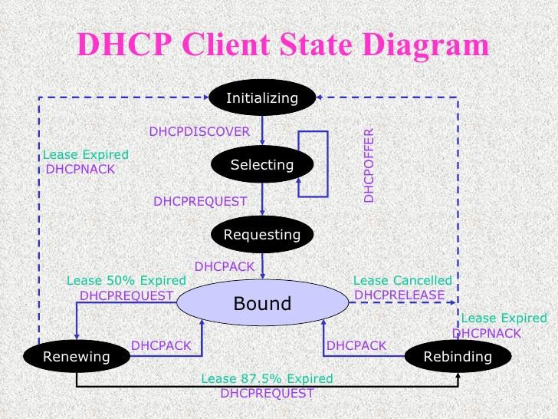
Message Flow
DHCP Client State Diagram

Slide 12
Message Flow
Initializing State
When DHCP client is in the Initializing state
its IPv4 address is 0.0.0.0 (unspecified address)
it tries to obtain an IPv4 address configuration by broadcasting a DHCPDiscover message from UDP port 67 to UDP port 68.
the source IPv4 address is 0.0.0.0
the destination is 255.255.255.255
DHCPDiscover message contains the DHCP client’s media access control (MAC) address and computer name.
If a DHCP server is on the DHCP client's subnet, the server receives the broadcast DHCPDiscover message.
If no DHCP server on the DHCP client’s subnet, a DHCP relay agent on the DHCP client’s subnet receives the broadcast DHCPDiscover message and relays it as a unicast DHCPDiscover message from the DHCP relay agent to one or more DHCP servers

Slide 13
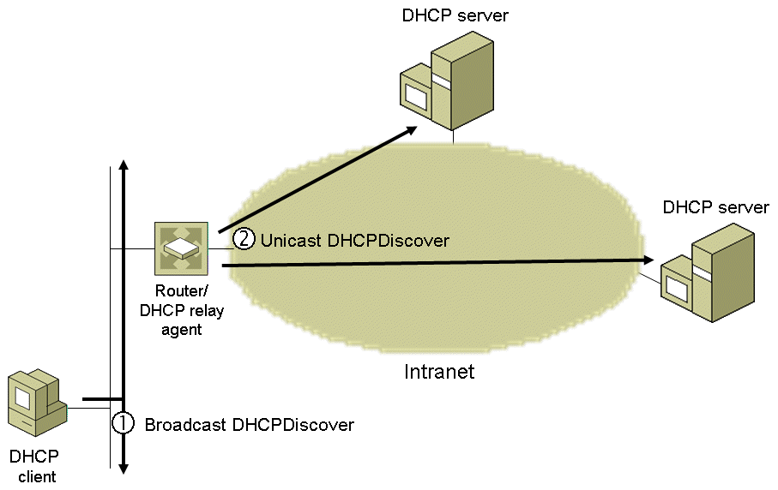
Message Flow
Initializing State (cont)

Slide 14
Message Flow
Initializing State (cont)
Before forwarding the original DHCPDiscover message, the DHCP relay agent makes the following changes:
Increments the Hops field in the DHCP header
If the value of the Giaddr (Gateway IP Address) field in the DHCP header is 0.0.0.0 (as set by the originating DHCP client), changes the value to the IPv4 address of the interface on which the DHCPDiscover message was received.
Changes the source IPv4 address of the DHCPDiscover message to an IPv4 address assigned to the DHCP relay agent.
Changes the destination IPv4 address of the DHCPDiscover message to the unicast IPv4 address of a DHCP server.

Slide 15
Message Flow
Selecting State
In the Selecting state, the DHCP client can select from the set of IPv4 address configurations that the DHCP servers offered.
The DHCP server uses the following process to determine the scope from which an IPv4 address for the DHCP client is to be selected and included in the DHCPOffer message:
If Giaddr is 0.0.0.0, set Giaddr to IPv4 address of the interface on which the DHCPDiscover message was received.
For each scope, perform a bit-wise logical AND of Giaddr with subnet mask of the scope. If the result matches the subnet prefix of the scope, the DHCP server allocates an IPv4 address from that scope.
The DHCPOffer messages contain the DHCP client’s MAC address, an offered IPv4 address, appropriate subnet mask, a server identifier (IPv4 address of the offering DHCP server), the length of the lease, and other configuration parameters

Slide 16
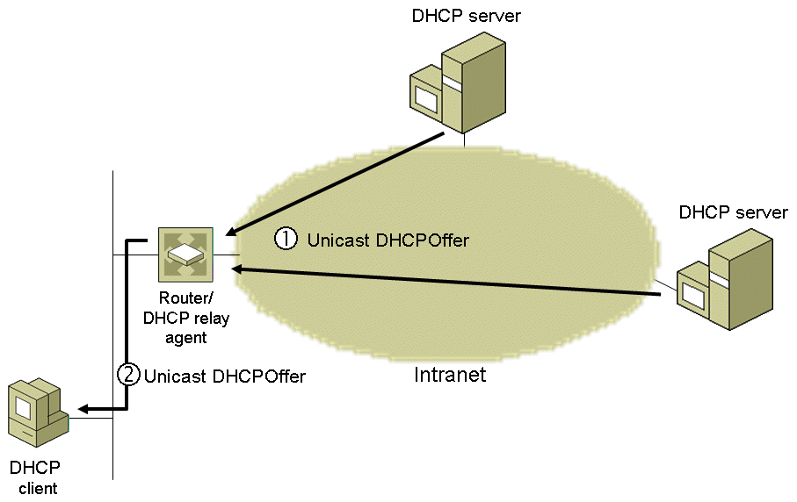
Message Flow
Selecting State (cont)

Slide 17
Message Flow
Requesting State
In the Requesting state, DHCP client requests a specific IP address configuration by broadcasting a DHCPRequest message
source IPv4 address is 0.0.0.0
destination IPv4 address is 255.255.255.255.
DHCPRequest message contains IPv4 address of DHCP server if IPv4 address configuration of the DHCP client was just obtained with a DHCPDiscover/DHCPOffer message exchange
DHCPRequest message doesn't contain IPv4 address of DHCP server if IPv4 address configuration of the client was previously known (e.g., the computer was restarted and is trying to renew its lease on its previous address)
when restarting, the DHCP client can renew its IPv4 address configuration from any DHCP server.
If DHCP client does not have a DHCP server on its subnet, a DHCP relay agent on its subnet receives the broadcast DHCPRequest message and relays it as a unicast DHCPRequest message from the DHCP relay agent to one or more DHCP servers.

Slide 18
Message Flow
Selecting State (cont)

Slide 19
Message Flow
Selecting State (cont)

Slide 20
Message Flow
Selecting State (cont)

Slide 21
Message Flow
Selecting State (cont)

Slide 22
Message Flow
Selecting State (cont)

Slide 23
Message Flow
Selecting State (cont)

Slide 24
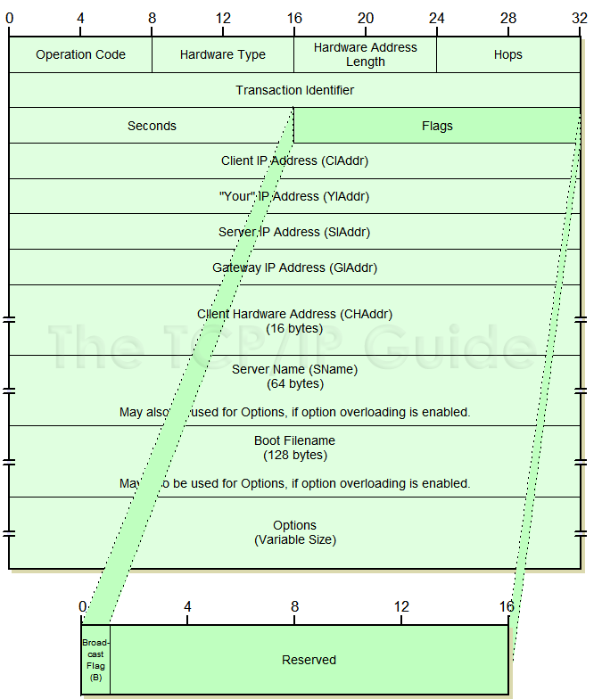
Message Flow
DHCP Message Format

Slide 25
Message Flow
Message Op Code (Op): a 1-byte field indicating whether the message is a request (set to 1) or a reply (set to 2)
Hardware Address Type (Htype): a 1-byte field indicating the type of hardware being used by the DHCP client (e.g., Ethernet, Frame Relay, ATM)
Hardware Address Length (Hlen): a 1-byte field indicating the number of high order bytes within the fixed-length Client Hardware Address field that contains the client’s hardware address (= 6 for Ethernet)
Hops: a 1-byte field indicating how many DHCP relay agents have forwarded the message. The initial value is 0.
When a DHCP relay agent forwards a DHCP message on behalf of either a DHCP client or a DHCP server, it increments this field.
The maximum number of hops in a DHCP infrastructure is 16. If the value is greater than 16, the receiving DHCP relay agent silently discards the message.
DHCP relay agents can also discard DHCP messages if this field exceeds a configurable value (e.g., Windows Server 2008 uses a default maximum of 4 hops)
Note: this field is different from the Time to Live (TTL) field in the IPv4 header

Slide 26
Message Flow
Transaction ID (Xid): a 4-byte field containing a random number derived by the DHCP client to group all of the DHCP messages of a given message exchange together
Seconds (Secs): a 2-byte field set by the DHCP client to indicate the number of seconds that have elapsed since the client began the address acquisition process (may be used by a busy DHCP server to prioritize replies when multiple client requests are outstanding.)
Flags: a 2-byte field indicating flags set by the DHCP client. RFC 2131 defines the leftmost bit as the Broadcast flag (set to 1 to indicate client cannot receive unicast IP datagrams)
Some clients cannot accept IP unicast datagrams before the TCP/IP software is configured (packets delivered to the client's hardware address is not forwarded to IP layer)
Windows Server 2008 and Windows Vista: DHCP client set the Broadcast flag to 1 (responses must be broadcast).
Windows Server 2003 and XP: DHCP client sets Broadcast flag to 0 (allows unicast responses)
By default, Windows DHCP servers ignore the Broadcast bit on the client requests (DHCP responses are sent as IP broadcasts to the limited broadcast address 255.255.255.255). To configure the DHCP Server to process the Broadcast flag, create and set the IgnoreBroadcastFlag registry value to 0

Slide 27
Message Flow
Client IP Address (Ciaddr): A 4-byte field indicating a DHCP client’s IP address,
set by the DHCP client when it has been successfully configured with the IP address (Bound, Renewing, and Rebinding states) and can respond to ARP requests to defend the use of the address.
client does not use this field to request a particular IP address in a lease; it uses the Requested IP Address option
Your IP Address (Yiaddr): a 4-byte field indicating the IP address being allocated to the DHCP client by the DHCP server
Server IP Address (Siaddr): a 4-byte field indicating the IP address of the server that the client should use for the next step in the bootstrap process (which may or may not be the server sending this reply), returned in DHCPOFFER, DHCPACK by server
The sending server always includes its own IP address in the Server Identifier option

Slide 28
Message Flow
Gateway IP Address (Giaddr): a 4-byte field indicating an IP address assigned to the interface on the initial DHCP relay agent that received the message from the DHCP client.
The initial DHCP relay agent is located on the same subnet as the DHCP client that broadcast the DHCP request message (either a DHCPDISCOVER or DHCPREQUEST message).
By recording an IP address for the subnet of the DHCP client in this field, the DHCP server can determine the proper scope from which to assign an IP address to the requesting DHCP client.
Client Hardware Address (Chaddr): a 16-byte field indicating the hardware address of the DHCP client (contains the 6-byte MAC address for Ethernet)
Server Host Name (Sname): a 64-byte field indicating a name for the DHCP server (DHCP Server in Windows Server 2008 does not use this field)

Slide 29
Message Flow
Boot File Name (File): a 128-byte field indicating the name of the file containing a boot image for a BOOTP client.
BOOTP was developed before DHCP to allow a diskless host computer to obtain an IP address configuration, the name of a boot file, and the location of a Trivial File Transfer Protocol (TFTP) server from which the computer loads the boot file.
DHCP message exchanges do not use this field.
Options: a variable-length set of fields containing DHCP options. Subnet Mask, Name Server, Hostname, Domain Name, Forward On/Off, Default IP TTL, Broadcast Address, Static Route, Ethernet Encapsulation, X Window Manager, X Window Font, DHCP Msg Type, DHCP Renewal Time, DHCP Rebinding, Time SMTP-Server, SMTP-Server, Client FQDN, Printer Name…

Slide 30
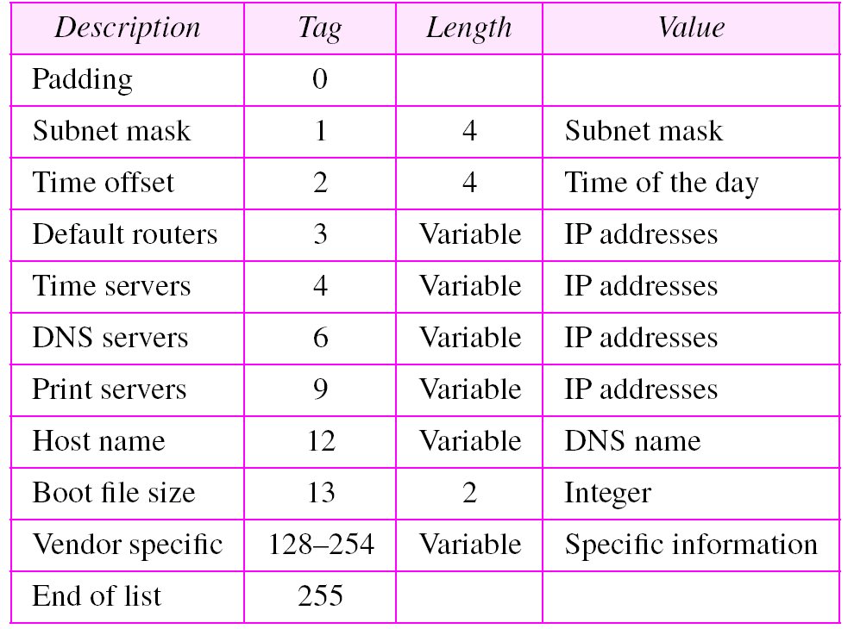
Message Flow
DHCP Option Examples
Further reference at: http://www.networksorcery.com/enp/protocol/bootp/options.htm

Slide 31
Message Flow
Fields used by DHCP clients
Field | DHCPDISCOVER, DHCPINFORM | DHCPREQUEST | DHCPDECLINE, DHCPRELEASE
'op' | BOOTREQUEST | BOOTREQUEST | BOOTREQUEST
'htype' | (from RFC) | (from RFC) | (from RFC)
'hlen' | (length in octets) | (length in octets) | (length in octets)
'hops' | 0 | 0 | 0
'xid' | selected by client | 'xid' from server DHCPOFFER message | selected by client
'secs' | 0 or seconds since DHCP process started | 0 or seconds since DHCP process started | 0
'flags' | Set 'BROADCAST' flag if client requires broadcast reply | Set 'BROADCAST' flag if client requires broadcast reply | 0
'ciaddr' | 0 (DHCPDISCOVER) or client's network address (DHCPINFORM) | 0 or client's network address (BOUND/RENEW/REBIND) | 0 (DHCPDECLINE) or client's network address (DHCPRELEASE)
'yiaddr' | 0 | 0 | 0
'siaddr' | 0 | 0 | 0
'giaddr' | 0 | 0 | 0
'chaddr' | client's hardware address | client's hardware address | client's hardware address
'sname' | options, if indicated in 'sname/file' option; otherwise unused | options, if indicated in 'sname/file' option; otherwise unused | (unused)
'file' | options, if indicated in 'sname/file' option; otherwise unused | options, if indicated in 'sname/file' option; otherwise unused | (unused)
'options' | options | options | (unused)

Slide 32
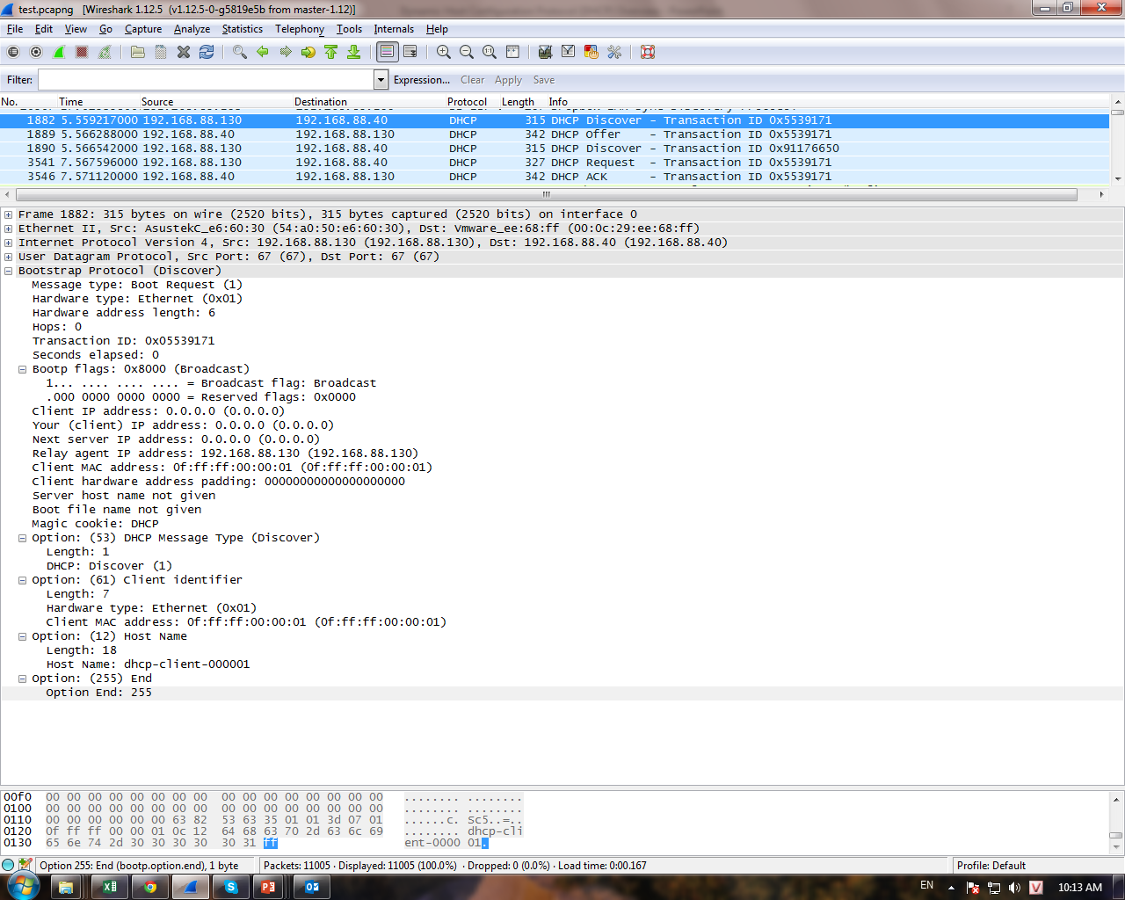

Slide 33
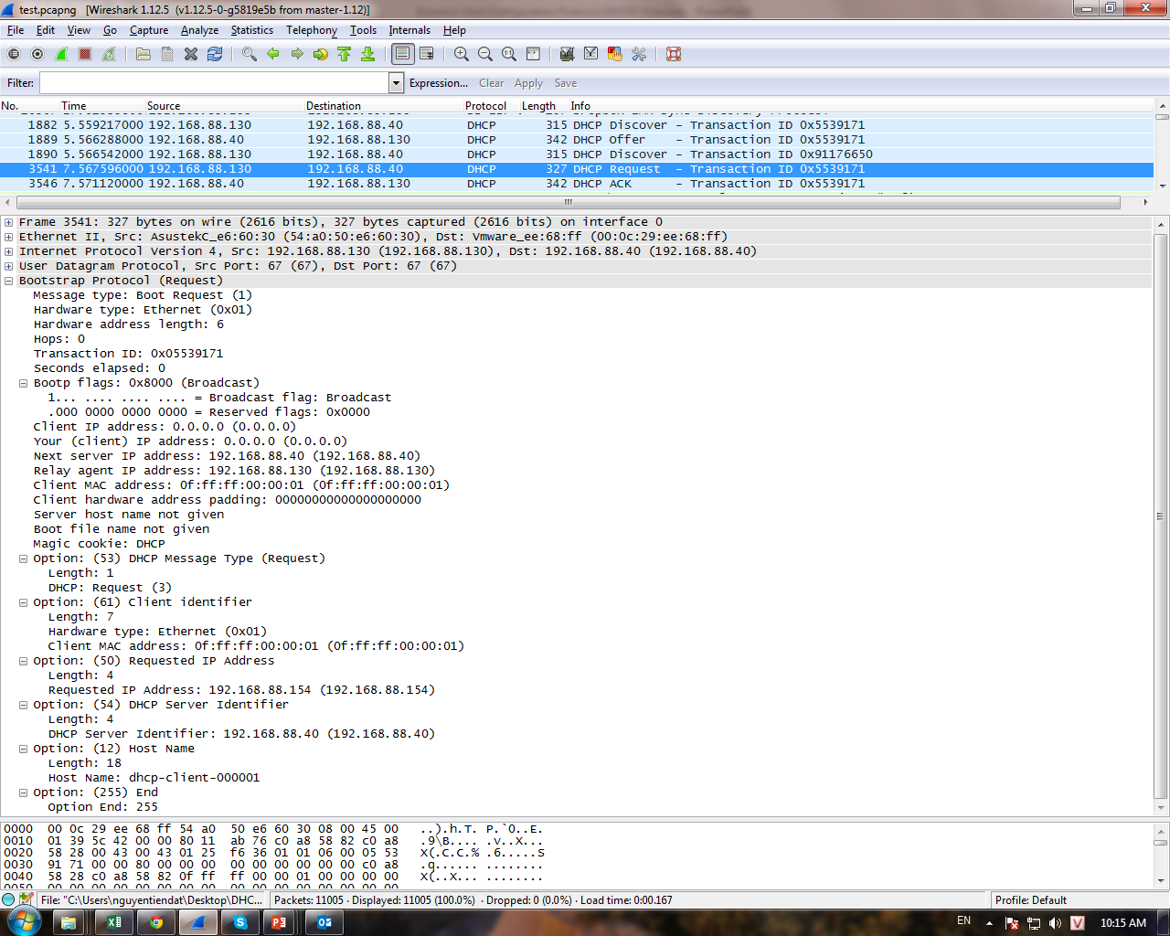

Slide 34
Initial Message Flow
Fields used by DHCP Server
Field | DHCPOFFER | DHCPACK | DHCPNAK
'op' | BOOTREPLY | BOOTREPLY | BOOTREPLY
'htype' | (from RFC) | (from RFC) | (from RFC)
'hlen' | (length in octets) | (length in octets) | (length in octets)
'hops' | 0 | 0 | 0
'xid' | 'xid' from client DHCPDISCOVER message | 'xid' from client DHCPDISCOVER message | 'xid' from client DHCPDISCOVER message
'secs' | 0 | 0 | 0
'ciaddr' | 0 | 'ciaddr' from DHCPREQUEST or 0 | 0
'yiaddr' | IP address offered to client | IP address assigned to client | 0
'siaddr' | IP address of next bootstrap server | IP address of next bootstrap server | 0
'flags' | 'flags' from client DHCPDISCOVER message | 'flags' from client DHCPREQUEST message | 'flags' from client DHCPREQUEST message
'giaddr' | 'giaddr' from client DHCPDISCOVER message | 'giaddr' from client DHCPREQUEST message | 'giaddr' from client DHCPREQUEST message
'chaddr' | 'chaddr' from client DHCPDISCOVER message | 'chaddr' from client DHCPREQUEST message | 'chaddr' from client DHCPREQUEST message
'sname' | Server host name or options | Server host name or options | (unused)
'file' | Client boot file name or options | Client boot file name or options | (unused)
'options' | options | options | (unused)

Slide 35
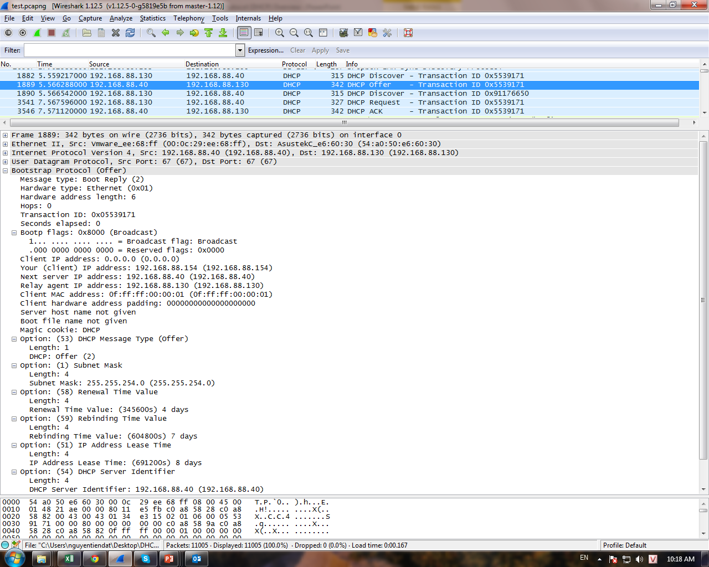

Slide 36
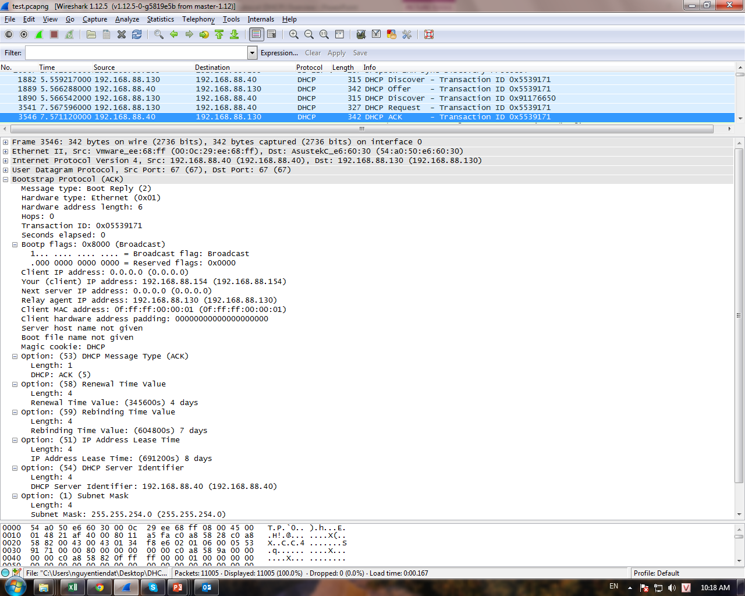

Slide 37
DHCP Relay Agents

